Slide 1
JS Frameworks Overview
Introducing Vue over Angular, React and Redux

Slide 2
Various JS Frameworks
Jquery
Angular
React.js
Node.js
Titanium Framework
Ember.js
And More..
Vue.js
Backbone.js
Knockout.js
Polymer
Riot
Express.js

Slide 3
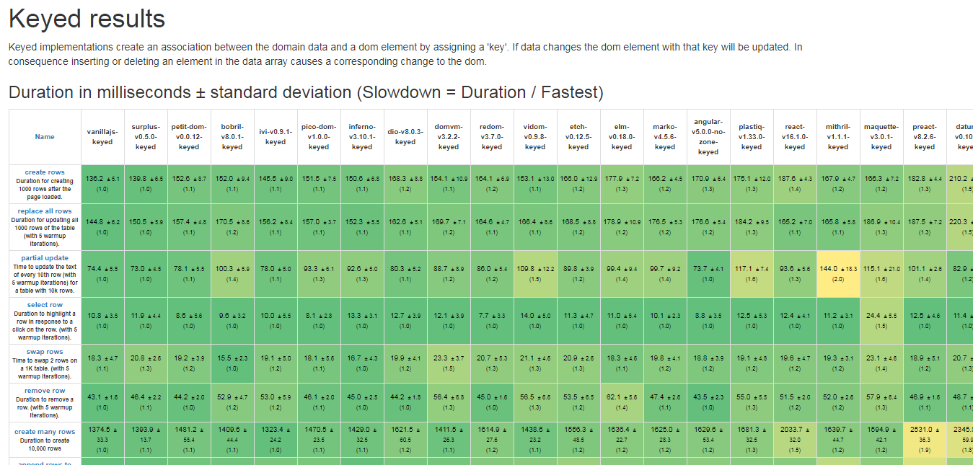
Too many choices leads to confusion
https://www.stefankrause.net/js-frameworks-benchmark7/table.html
https://www.stefankrause.net/js-frameworks-benchmark7/table.html benchmark, which focuses on raw render/update performance with very simple component trees.

Slide 4
Bringing frontend and backend together with Vue, Vuex and Node JS

Slide 5
Vue.js
Simple
No Build Process
Scalable
utilize a virtual DOM
provide reactive and composable view components
maintain focus in the core library, with concerns such as routing and global state management handled by companion libraries

Slide 6
Advantages using Vue.js over
React JS
Vue has better performance and is much, much easier to optimize
In Vue, a component’s dependencies are automatically tracked during its render
JSX vs Templates
Component-Scoped CSS
Scaling Up and Down
Native Rendering
Angular JS
TypeScript
Runtime Performance
Size
Flexibility and Modularity
Complexity
Learning Curve

Slide 7
Vuex
At the center of every Vuex application is the store.
Vuex stores are reactive. When Vue components retrieve state from it, they will reactively and efficiently update if the store's state changes.
You cannot directly mutate the store's state. The only way to change a store's state is by explicitly committing mutations.

Slide 8
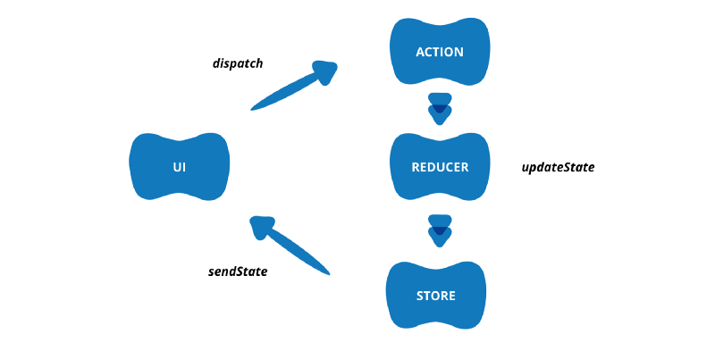
Redux vs. Vuex
Redux
Vuex
State tree: It is an object that contains all the states at the application level .
Getters: It is used to access the data in the tree from our Vue component.
Mutators: Events that serve to modify the states of the tree.
Actions: Functions called from the components of Vue to trigger the mutations.

Slide 9
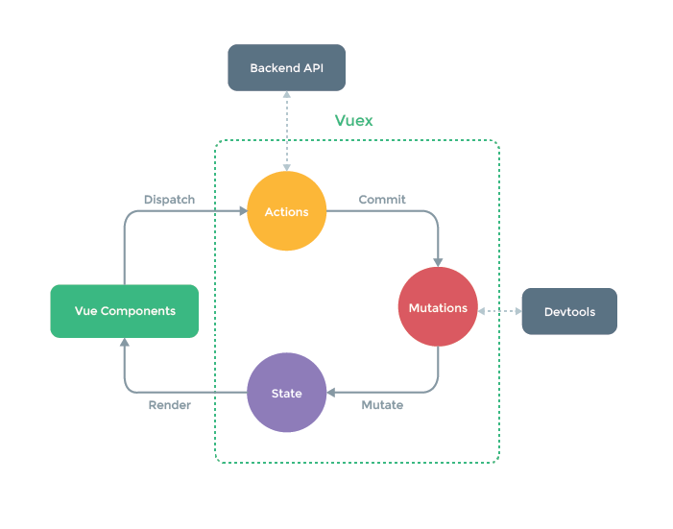
Vuex

Slide 10
References
https://vuejs.org/v2/guide/
https://vuejs.org/v2/api/
https://vuejs.org/v2/style-guide/
https://vuex.vuejs.org/guide/

